Slide 1
18CSC202J - OBJECT ORIENTED DESIGN AND PROGRAMMING
Session 5
Topic : STL Algorithm
Function Objects

Slide 2
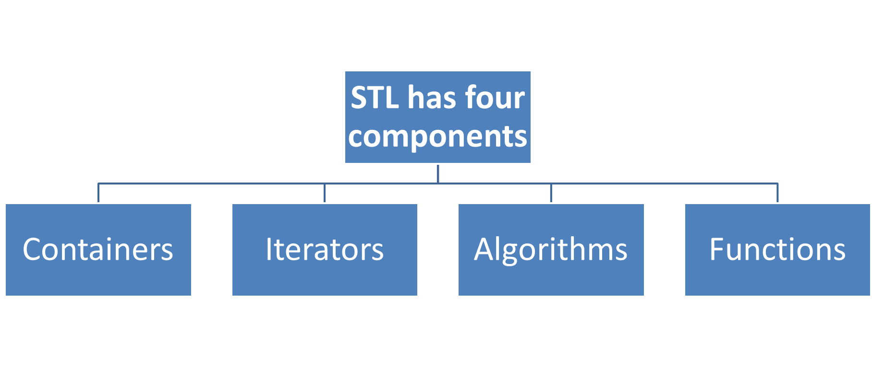

Slide 3
STL Algorithms
Are used to point at the memory addresses of STL containers.
They are primarily used in sequence of numbers, characters etc.
They reduce the complexity and execution time of program.

Slide 4
STL ALgorithms
STL has an ocean of algorithms, for all < algorithm > library functions
Some of the most used algorithms on vectors and most useful one’s in Competitive Programming are mentioned as follows :
  sort(first_iterator, last_iterator) – To sort the given vector.
  reverse(first_iterator, last_iterator) – To reverse a vector.
  *max_element (first_iterator, last_iterator) – To find the maximum element of a vector.
  *min_element (first_iterator, last_iterator) – To find the minimum element of a vector.
  accumulate(first_iterator, last_iterator, initial value of sum) – Does the summation of vector elements

Slide 5
// Reversing the Vector
reverse(vect.begin(), vect.end());
cout << "\nVector after reversing is: ";
for (int i=0; i<6; i++)
cout << vect[i] << " ";
cout << "\nMaximum element of vector is: ";
cout << *max_element(vect.begin(), vect.end());
cout << "\nMinimum element of vector is: ";
cout << *min_element(vect.begin(), vect.end());
// Starting the summation from 0
cout << "\nThe summation of vector elements is: ";
cout << accumulate(vect.begin(), vect.end(), 0);
return 0;
}
// A C++ program to demonstrate working of sort(), reverse()
#include <algorithm>
#include <iostream>
#include <vector>
#include <numeric> //For accumulate operation
using namespace std;
int main()
{
// Initializing vector with array values
int arr[] = {10, 20, 5, 23 ,42 , 15};
int n = sizeof(arr)/sizeof(arr[0]);
vector<int> vect(arr, arr+n);
cout << "Vector is: ";
for (int i=0; i<n; i++)
cout << vect[i] << " ";
// Sorting the Vector in Ascending order
sort(vect.begin(), vect.end());
cout << "\nVector after sorting is: ";
for (int i=0; i<n; i++)
cout << vect[i] << " ";
Output:
Vector before sorting is: 10 20 5 23 42 15 Vector after sorting is: 5 10 15 20 23 42 Vector before reversing is: 5 10 15 20 23 42 Vector after reversing is: 42 23 20 15 10 5 Maximum element of vector is: 42
Minimum element of vector is: 5
The summation of vector elements is: 115

Slide 6
count(first_iterator, last_iterator,x) – To count the occurrences of x in vector.
find(first_iterator, last_iterator, x) – Points to last address of vector ((name_of_vector).end()) if element is not present in vector.
// C++ program to demonstrate working of count() and find()
#include <algorithm>
#include <iostream>
#include <vector>
using namespace std;
int main()
{
// Initializing vector with array values
int arr[] = {10, 20, 5, 23 ,42, 20, 15};
int n = sizeof(arr)/sizeof(arr[0]);
vector<int> vect(arr, arr+n);
cout << "Occurrences of 20 in vector : ";
// Counts the occurrences of 20 from 1st to
// last element
cout << count(vect.begin(), vect.end(), 20);
// find() returns iterator to last address if
// element not present
find(vect.begin(), vect.end(),5) != vect.end()?
cout << "\nElement found":
cout << "\nElement not found";
return 0;
}
Output:
Occurrences of 20 in vector: 2 Element found

Slide 7
merge() in C++ STL
C++ offers in its STL library a merge() which is quite useful to merge sort two containers into a single container.
It is defined in header “algorithm“. It is implemented in two ways.
Syntax 1 : Using operator “<"

Slide 8
// C++ code to demonstrate the working of merge() implementation 1
#include <bits/stdc++.h>
using namespace std;
int main()
{
// initializing 1st container
vector<int> arr1 = { 1, 4, 6, 3, 2 };
// initializing 2nd container
vector<int> arr2 = { 6, 2, 5, 7, 1 };
// declaring resultant container
vector<int> arr3(10);
// sorting initial containers
sort(arr1.begin(), arr1.end());
sort(arr2.begin(), arr2.end());
// using merge() to merge the initial containers
merge(arr1.begin(), arr1.end(), arr2.begin(), arr2.end(), arr3.begin());
// printing the resultant merged container
cout << "The container after merging initial containers is : ";
for (int i = 0; i < arr3.size(); i++)
cout << arr3[i] << " ";
return 0;
}
Output:
The container after merging initial containers is : 1 1 2 2 3 4 5 6 6 7

Slide 9
Functors in C++

Slide 10
Function objects
Consider a function that takes only one argument.
However, while calling this function we have a lot more information that we would like to pass to this function, but we cannot as it accepts only one parameter. What can be done?
One obvious answer might be global variables.
However, good coding practices do not advocate the use of global variables and say they must be used only when there is no other alternative.
Functors are objects that can be treated as though they are a function or function pointer.
Functors are most commonly used along with STLs.

Slide 11
The functor allows an instance object of some class to be called as if it were an ordinary function.
Let us consider a function that takes one argument. We can use this function as function object to do some task on a set of data

Slide 12

#include <iostream>
#include <algorithm>
using namespace std;
int square(int x)
{
return x*x; //return square of x
}
int main()
{
int data[10] = {0, 1, 2, 3, 4, 5, 6, 7, 8, 9};
transform(data, data+10, data, square);// array name, elements, name, square and store
for (int i = 0; i<10; i++)
cout << data[i] << endl;
}
Output

Slide 13
// A C++ program uses transform() in STL to add 1 to all elements of arr[]
#include <bits/stdc++.h>
using namespace std;
int increment(int x) { return (x+1); }
int main()
{
int arr[] = {1, 2, 3, 4, 5};
int n = sizeof(arr)/sizeof(arr[0]);
// Apply increment to all elements of
// arr[] and store the modified elements
// back in arr[]
transform(arr, arr+n, arr, increment);
for (int i=0; i<n; i++)
cout << arr[i] << S" ";
return 0;
}
Output:
2 3 4 5 6

